Slide 1
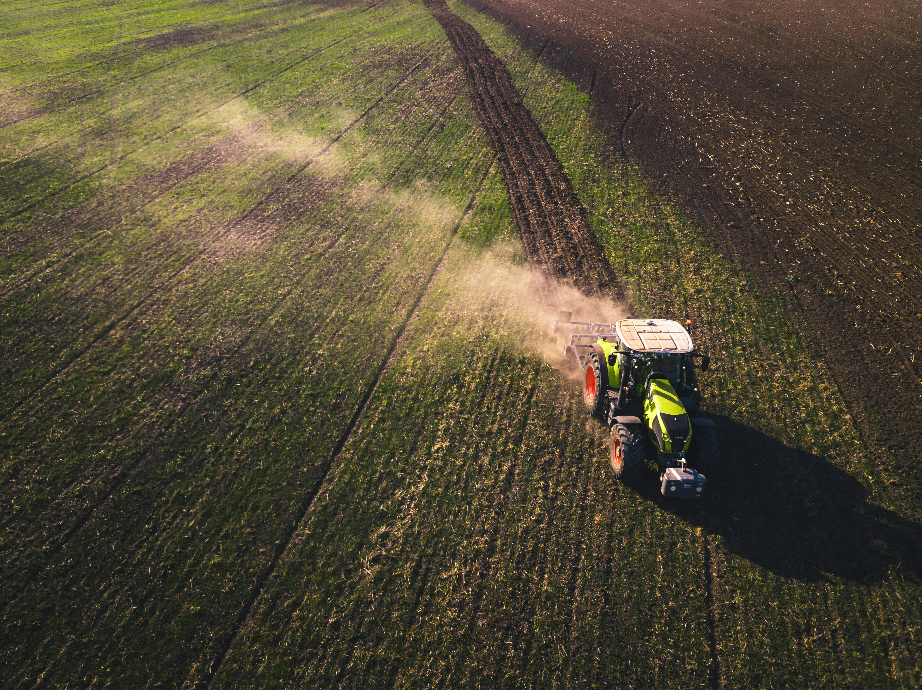
CROP YIELD PREDICTION USING MACHINE LEARNING
Data Science Capstone Project
By: Mustafa Mahmood
PKLH-DEC2024-DSAI-9

Slide 2


Project Overview & Problem Statement
Project Overview
Problem Statement
This project uses machine learning to predict crop yields based on rainfall, temperature, pesticide use, and crop type. It aims to provide data-driven insights to help optimize agricultural productivity.
Farmers often lack accurate tools to predict crop yields.
This model offers a scalable and efficient solution to improve decision-making using environmental data.

Slide 3

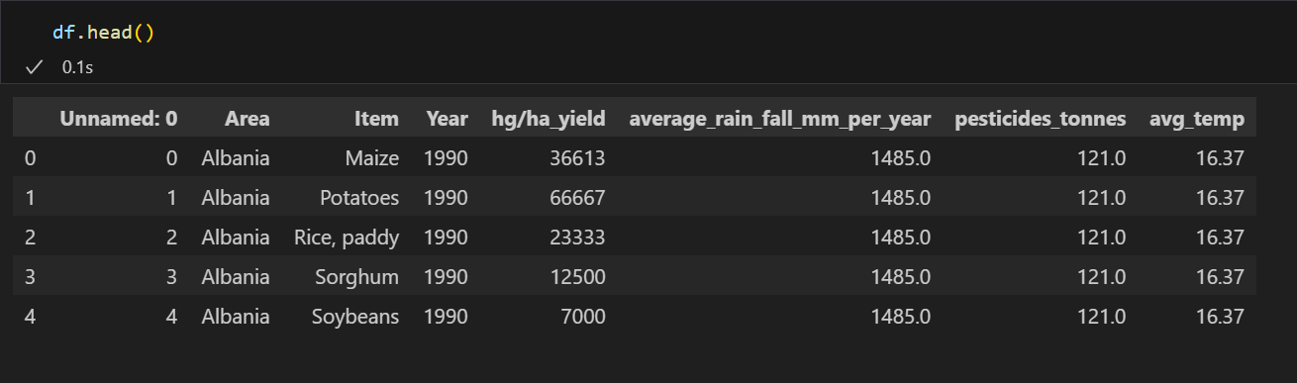
ABOUT THE DATASET
The dataset used in this project was sourced from the Food and Agriculture Organization (FAO) and the World Data Bank. It includes multi-year agricultural data from a single country and crop types.
Source: https://www.kaggle.com/datasets/patelris/crop-yield-prediction-dataset/data
Key Features:
Average Rainfall (mm/year)
Average Temperature (C)
Pesticide Use (tonnes)
Crop Types (13 crops)
Target Variable:
Crop Yield (hectograms per hectare – hg/ha)
Total Records: 20,000+
Total columns: 8
This Dataset enabled the development of a machine learning model to predict yield based on environmental and crop-type factors.

Slide 4

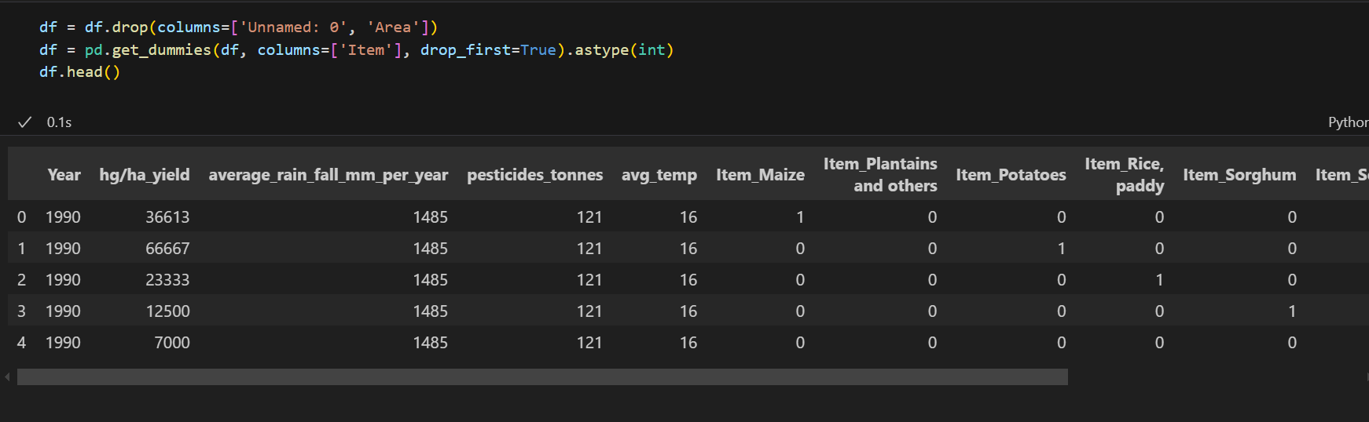
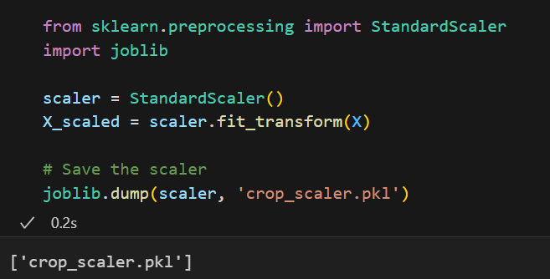

DATA CLEANING & PRE-PROCESSING
STEPS PERFROMED
. Removed null and duplicate records
. One-Hot Encoded column names
. Scaled Features – using StandardScaler()
. Converted final dataset into X (Features) and y (target)
WHY ITS IMPORTANT
. Ensures model is trained on clean, reliable data
. Encoding allows categorical input for ML models
. Scaling prevents bias from large numeric ranges
. Preprocessing improves model accuracy and performance

Slide 5

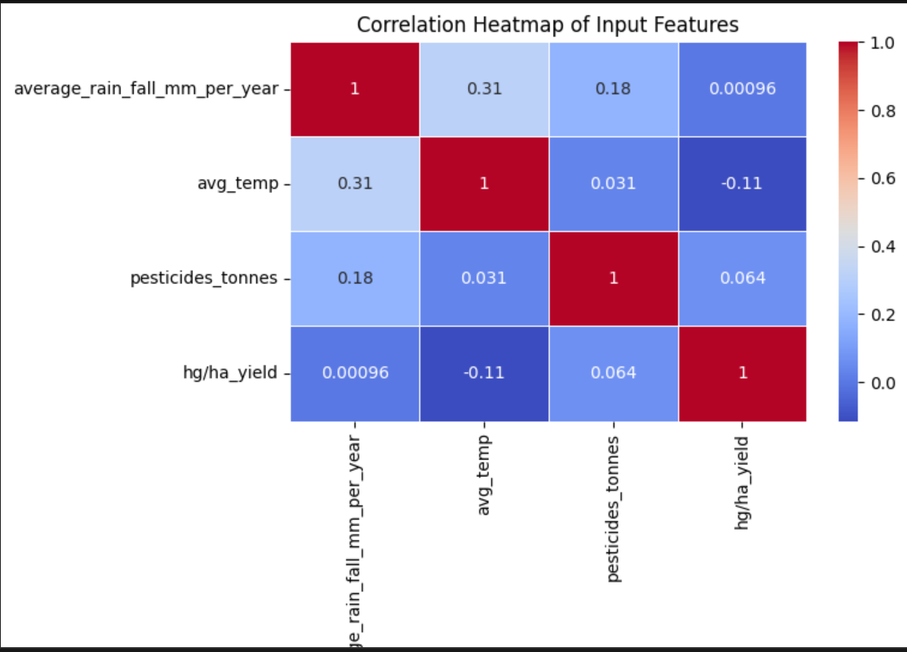
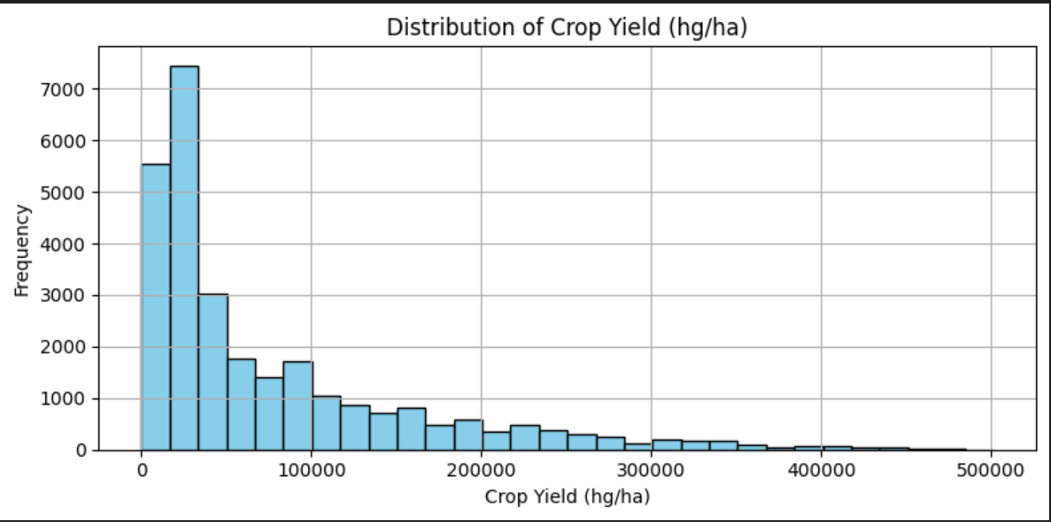
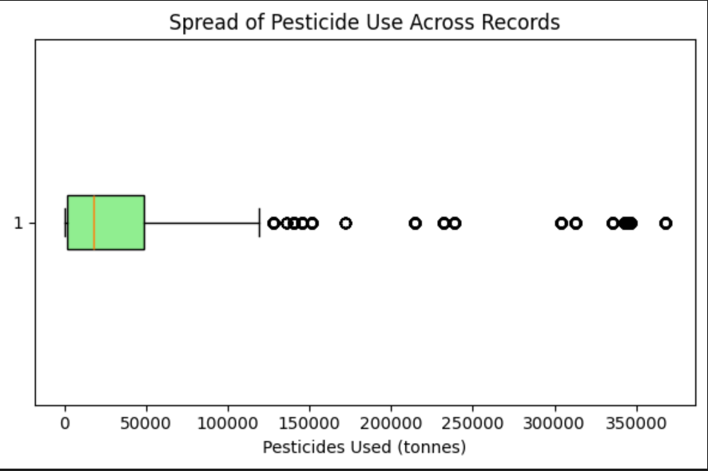
EXPLORATORY DATA ANALYSIS (EDA)
KEY FINDINGS
. Distribution of crop yield shows high variability across years and crop types
. Rainfall and temperature distributions are slightly skewed
. Strong correlation observed between rainfall and crop yield
. Outliers detected in pesticide usage, requiring scaling
. Some crops like (Potatoes, Maize, Rice) consistently yield higher than others.
“Correlation of input features with Crop Yield”
“Low correlation observed between inputs & yield”
“Distribution of Crop Yield”
“Spread of Pesticide Use”
“Pesticide use has extreme outliers”
“Yield distribution is right-skewed”

Slide 6


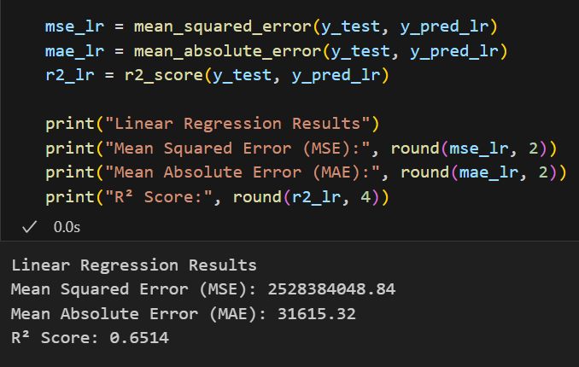
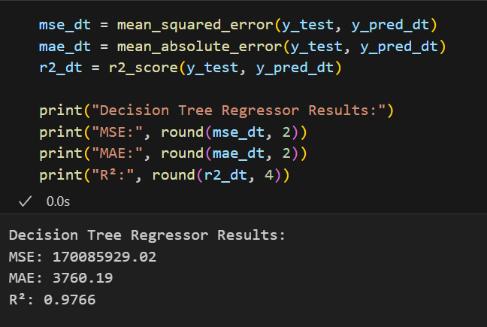
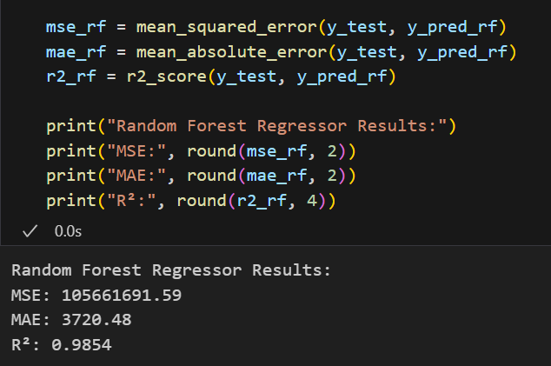
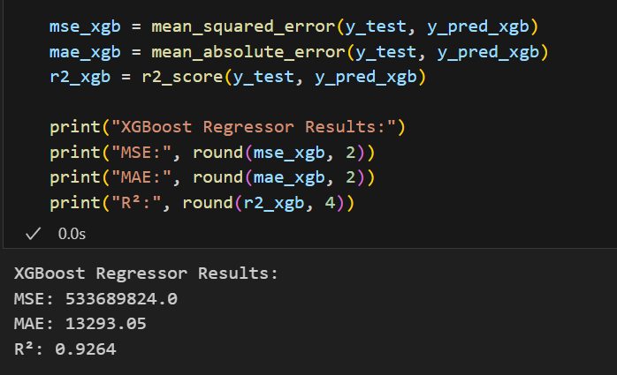
MODEL BUILDING & EVALUATION
MODELS USED:
1. Linear Regression:
Baseline model to establish linear relationships.
2. Decision-Tree Regressor:
Captures not-linear patterns using tree-based splits.
3. Random Forest Regressor: BEST RESULTS
Ensemble of decision trees offering high accuracy and reduced overfitting.
4. XGBoost Regressor:
Boosted ensemble model optimized for speed and performance.
MODEL EVALUATION RESULTS:
BEST PERFROMING MODEL

Slide 7

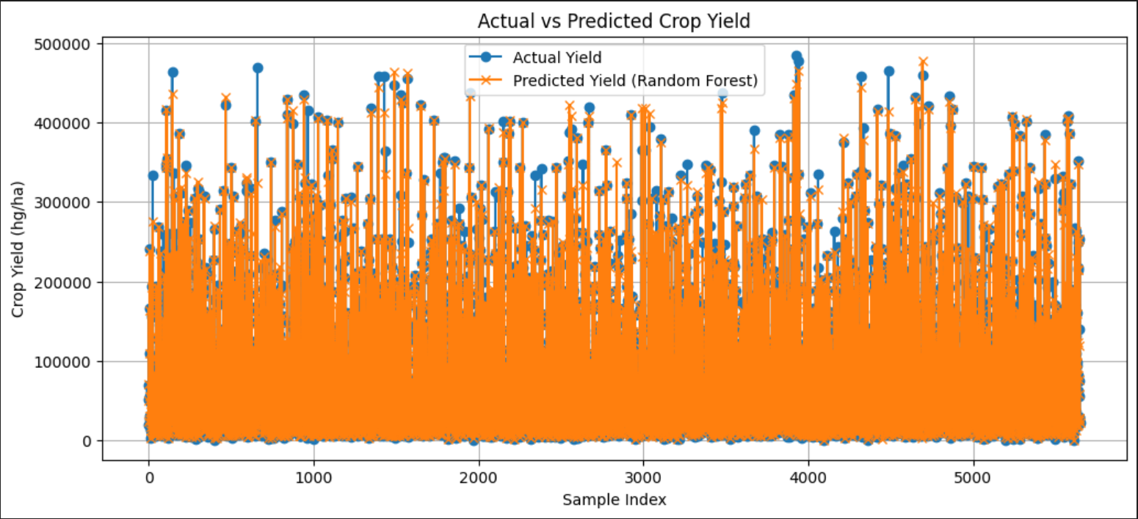
FINAL MODEL RESULTS
RANDOM FOREST: Final Model Results
. Delivered the Best Performance among all models.
. Achieved R2 Score: 0.988 and MAE: 3728 hg/ha.
. Strong alignment between actual and predicted values
. Suitable for real-world applications due to its accuracy and robustness
“High overlap between actual and predicted values confirms the models strong predictive ability”

Slide 8

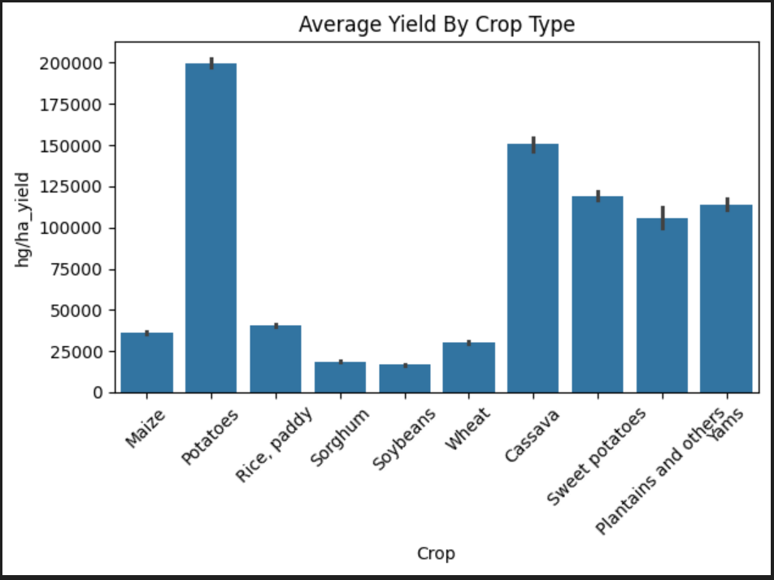
CROP-WISE YIELD ANALYSIS
KEY OBSERVATIONS:
“Insights from Crop Type Performance”
Potatoes, Cassava, and Sweet Potatoes show the highest average yields
Sorghum and Soybeans exhibit comparatively lower yields.
Highlights the importance of crop selection in maximizing output.
Reflects how different crops respond to environmental factors.
“Potatoes consistently outperform other crops in yield performance

Slide 9

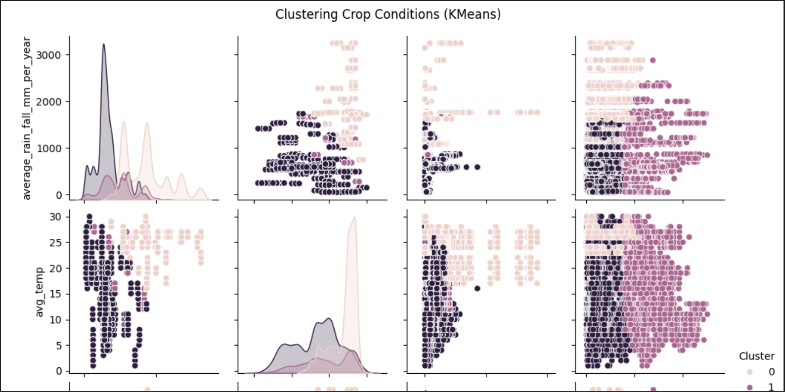
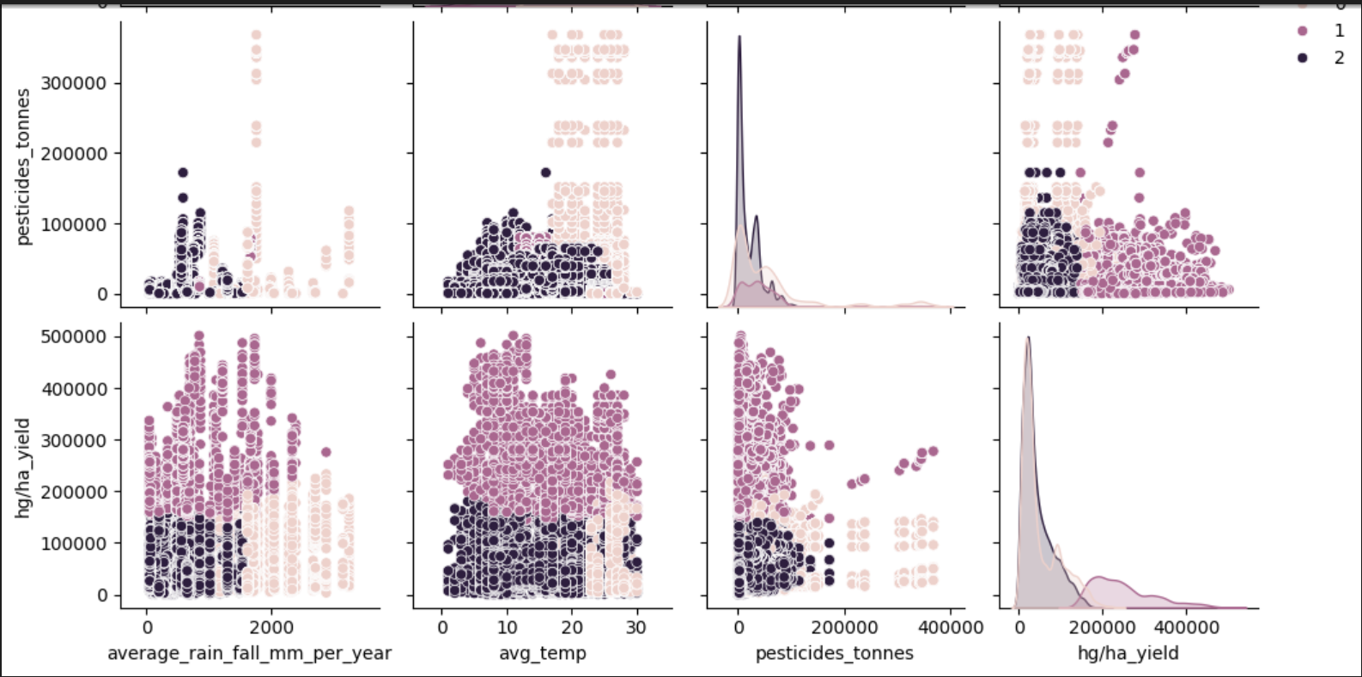
CLUSTERING ANALYSIS (KMEANS)
Key Insights:
VISUALIZATION
Applied KMeans Clustering to identify distinct crop growing conditions.
Clusters were based on rainfall, temperature, and pesticide usage
Helped uncover natural groupings in the data, revealing patterns not visible through direct observation.
Useful for segmenting regions or recommendation systems based on optimal crop conditions.
Enhances understanding of how different environmental conditions influence yield outcomes.
“Clusters reveal how crop yield responds to varying environmental conditions”

Slide 10
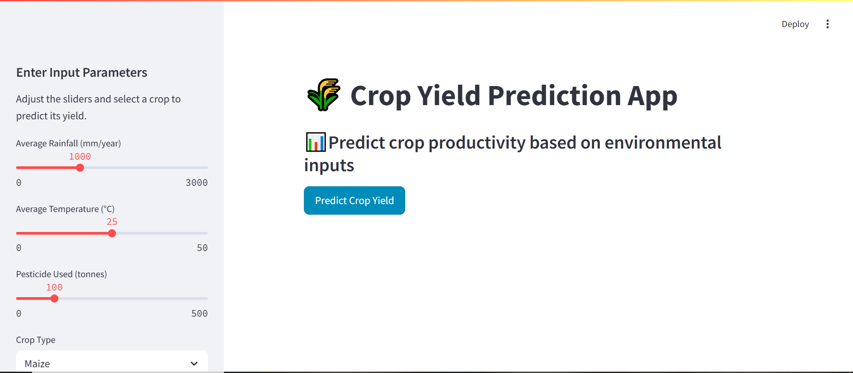
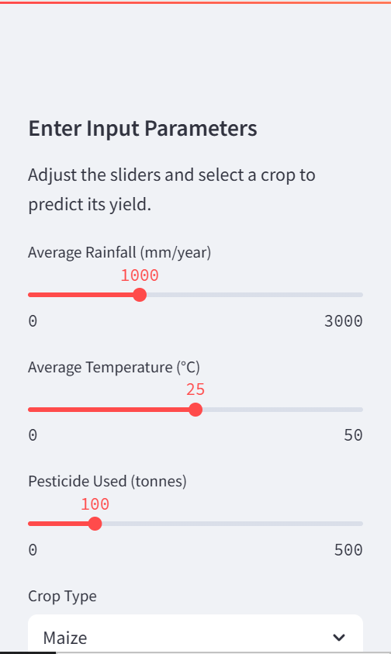
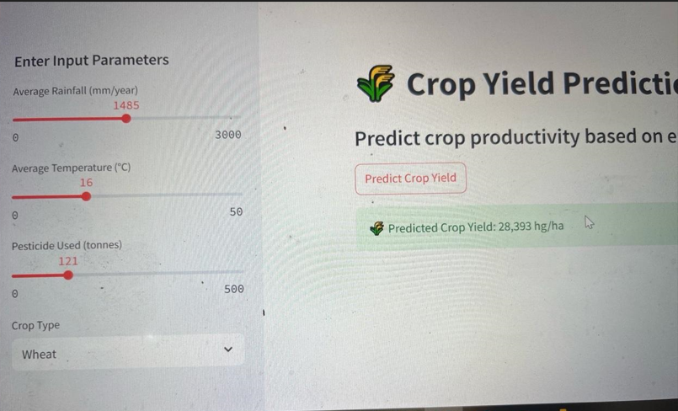
STREAMLIT APP DEMO
KEY FEATURES:
“Full UI View
User-friendly interface for predicting crop yield
Inputs: Rainfall, temperature, pestucide use, and crop type.
Output: Predicted yield in hg/ha using the Random Forest Model
Real-time predictions using scaled inputs.
Model and scaler integrated using joblib.
User enters environmental inputs.
App applies one-hot encoding and scaling
Model returns yield prediction instantly
Designed for farmers, agronomists, and policymakers
Workflow
“While the app performed extremely well for certain crops, some crops showed signs of underfitting or overfitting, mainly due to scaling afterwards which was done.

Slide 11


LIMITATIONS AND FUTURE ENHANCEMENTS
Current Constraints:
Future Enhancements:
Limited Feature Scope: Key variables like soil type, humidity, and sunlight were not available, reducing model accuracy for some crops.
Data Imbalance: Some crops had significantly fewer data point, leading to lower prediction reliability.
Static model training: The model is trained on historical data and might not adapt to changing weather patterns or emerging crop diseases.
No spatial data: Regional insights and geolocation-based predictions are currently missing.
Integration of NDVI satellite imagery: Adding NDVI (Normalized Difference Vegetation Index) will help in detecting plant health and growth stages, leading to more nuanced predictions and early warning systems for crop failures.
Incorporating soil and climate data: Features like soil pH, moisture levels, wind speed would significantly boost the models awareness.
Real-Time data feeds: Connecting the app to APIs for weather updates or satellite feeds will enable live predictions and make the system more adaptive and field-ready.
Model retraining pipeline: Automating retraining as new data becomes available will keep predictions accurate over time and improve generalizability.

Slide 12
Thankyou!

